Slide 1

Regularizing your neural network
Other regularization
methods
deeplearning.ai

Slide 2
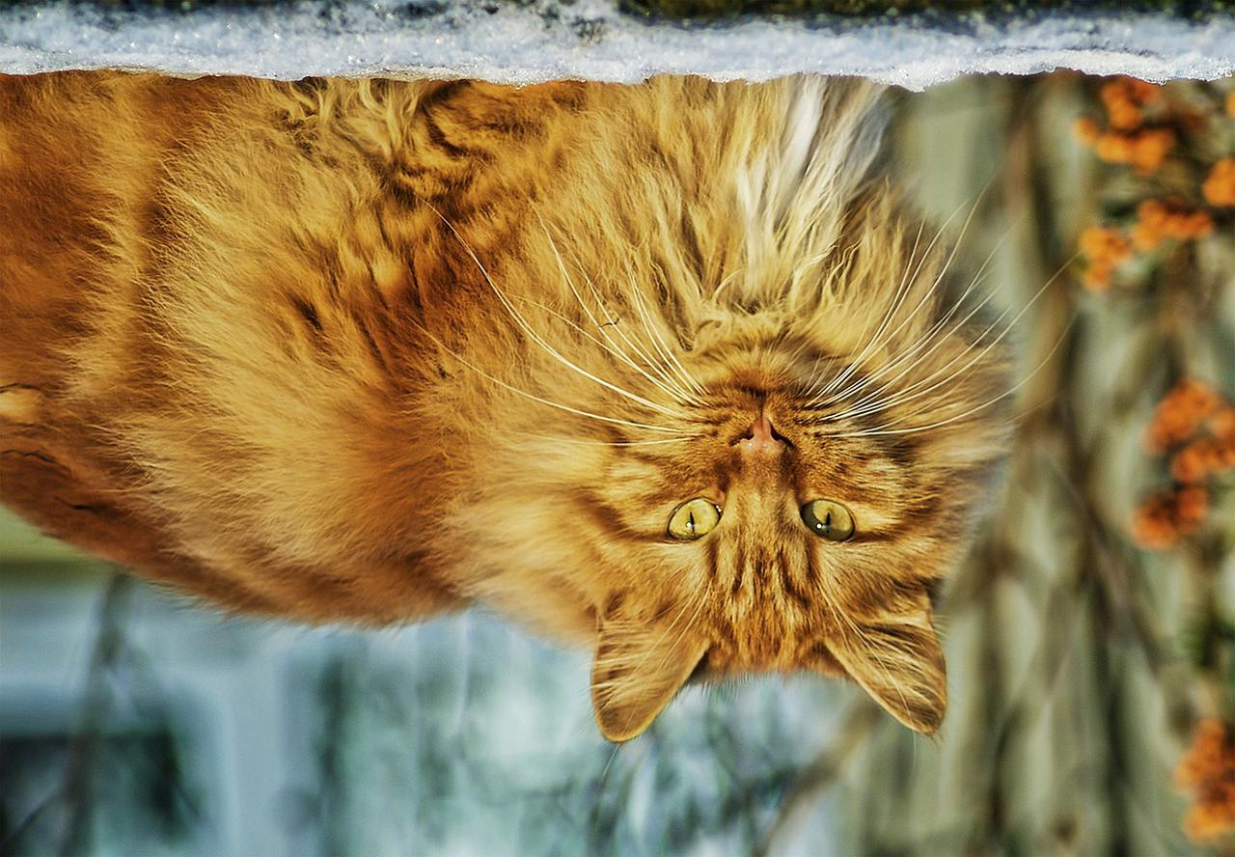
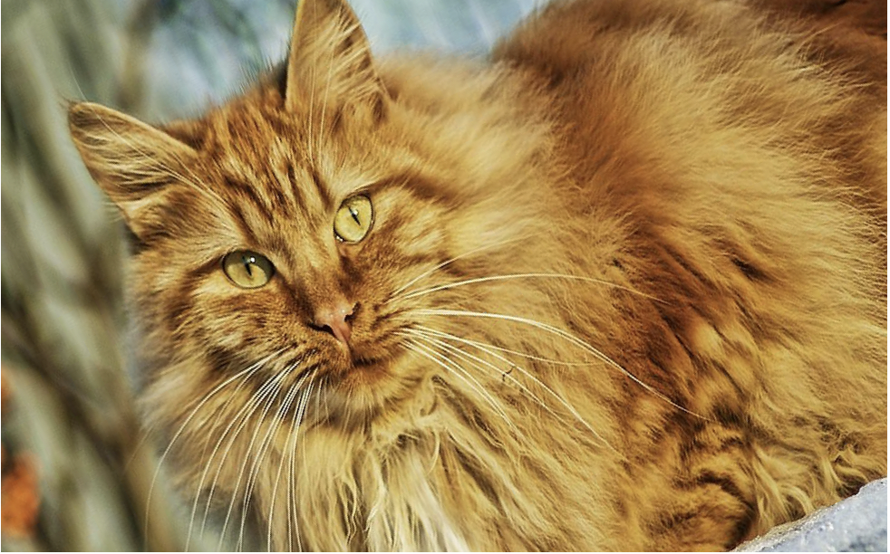

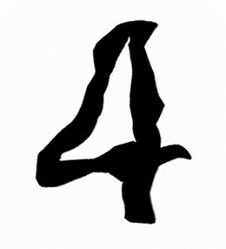
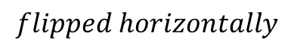
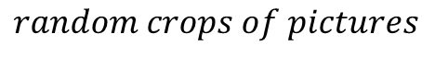
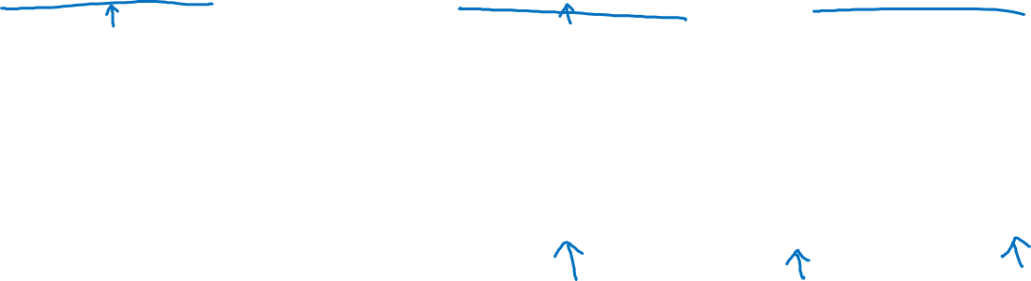
Data augmentation
$$flipped horizontally$$
$$random crops of pictures$$
4
$$random distortions of the image to increase number of synthetic examples$$

Slide 3
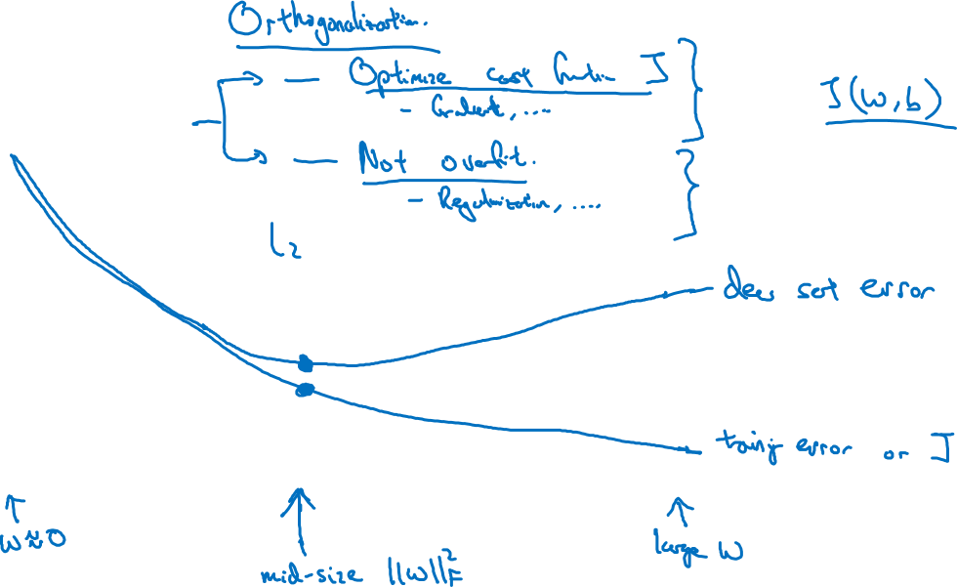
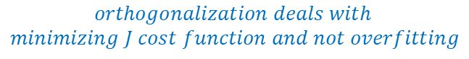
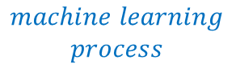
Early stopping
$$downside of the stopping earlier technique$$
$$orthogonalization deals with$$
$$minimizing J cost function and not overfitting$$
$$machine learning$$
$$process$$
# iterations

